Slide 1
DeepFakeDetection
IT499 - Biometric Security
Presented to: Prof. Shruti Bhilare
Dhirubhai Ambani Institute of Information
and Communication Technology
Team Members
Darpan Lunagariya - 2022 01462
Neel Patel - 2022 01494

Slide 2
PROBLEM STATEMENT
With the rapid advancement of AI tools, generating hyper-realistic fake images and videos has become fast and effortless. This surge in synthetic content brings serious consequences, including:
The spread of misinformation and fake news
Defamation and violations of personal privacy
Erosion of trust in digital media
As these manipulated visuals become increasingly convincing and widespread, there is a growing need for robust detection systems—especially ones capable of identifying fakes even after compression, a common practice on social media platforms that further obscures signs of tampering.

Slide 3

EXECUTION ROADMAP
Fetching frames from videos
Detecting face from the frames and storing them
Data Sourcing
Data Pre-processing
Model Selection
Model Training
Model Evaluation
Accuracy
InceptionV3
Confusion Matrix
ResNet18
ROC Curve
F1 score

Slide 4
DATASET AND DATA PREPROCESSING
Used Dataset: FaceForensics++
Manipulation Technique Used: DeepFakeDetection
We downloaded both original and manipulated videos and extracted 19th frame of each second to generate images from it.
we considered the compressed version of the video (c23) to extract images from it.
Used OpenCV library to do these operations.
After extracting images, we used MTCNN to crop face from the images.

Slide 5
MODEL SECLECTION
Other than classification models used in the study, we have considered following models to train for the deepfake detection purpose.
DenseNet
EfficientNet
InceptionV3
ResNet18
Out of these models, we chose below 2 models to train:
InceptionV3
ResNet18

Slide 6
INCEPTIONV3 MODEL
Reason why we considered InceptionV3 as a classifier model:
It has proven performance on image classification benchmarks, making it reliable for identifying manipulated content.
Capable of handling varied input resolutions and distortions, including compression artifacts common in social media videos.
Easy to fine-tune with transfer learning, reducing training time and improving convergence on limited deepfake datasets.

Slide 7
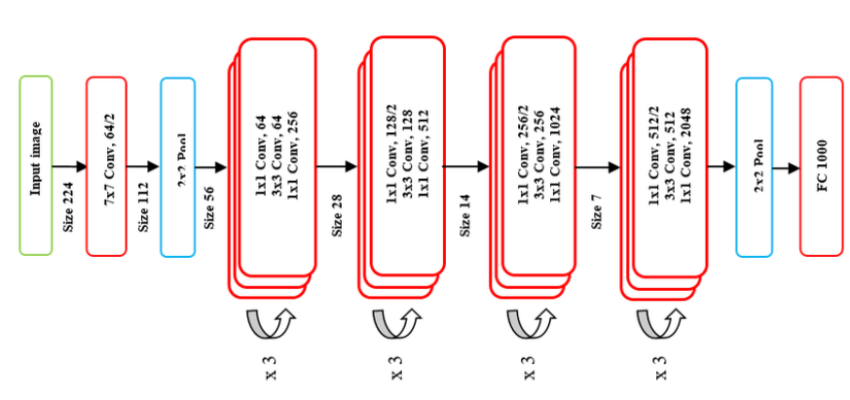
RESNET18 MODEL
Reason why we considered ResNet18 as a classifier model:
It prevents vanishing gradients, enabling effective training even at 18 layers deep.
It offers a great trade-off between speed and accuracy, that makes it ideal for real-time use.
It performs well on various datasets, especially with pre-trained weights (e.g., ImageNet).

Slide 8
TRAINING THE MODEL
Out of total 16793 images, we have considered the ratio of 0.7 for training set, 0.15 for validation set and remaining 0.15 for testing set. That results in:
11755 Training Images
2519 Validation Images
2519 Testing Images
Image Transformation:
First, we changed the resolution of the images to:
For XceptionV3: Image resolution is converted to 299 x 299
For ResNet18: Image resolution is converted to 224 x 224
After that, we normalized the images using the mean and std. deviation.

Slide 9
TRAINING THE MODEL
Optimizer: Adam
It combines the advantages of AdaGrad and RMSProp, adapting the learning rate for each parameter.
It offers fast convergence and works well for noisy or sparse gradients
Scheduler: ReduceLROnPlateau
It Monitors validation loss and reduces the learning rate when it stops improving.
By this, it helps the model escape local minima and fine-tune performance in later training stages.

Slide 10
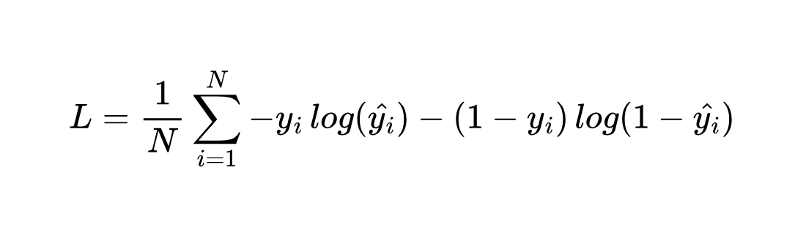
TRAINING THE MODEL
Loss Function: Binary Cross Entropy Function
Since it is a binary classification task, we have considered a Binary Cross Entropy Loss function.
It is defined as,
Where, y_i is the ground truth for sample i
y_i hat is the predicted probability of the sample being in the class i.

Slide 11
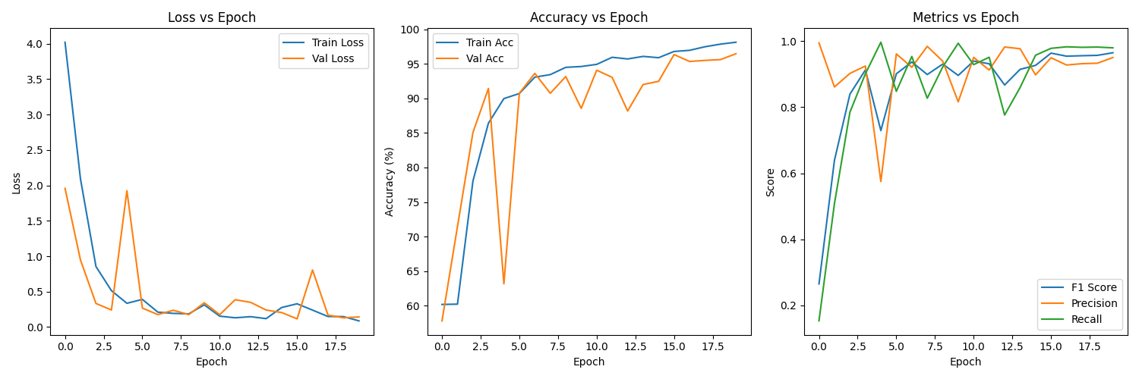
MODEL EVALUATION : INCEPTIONV3 MODEL
Training History

Slide 12
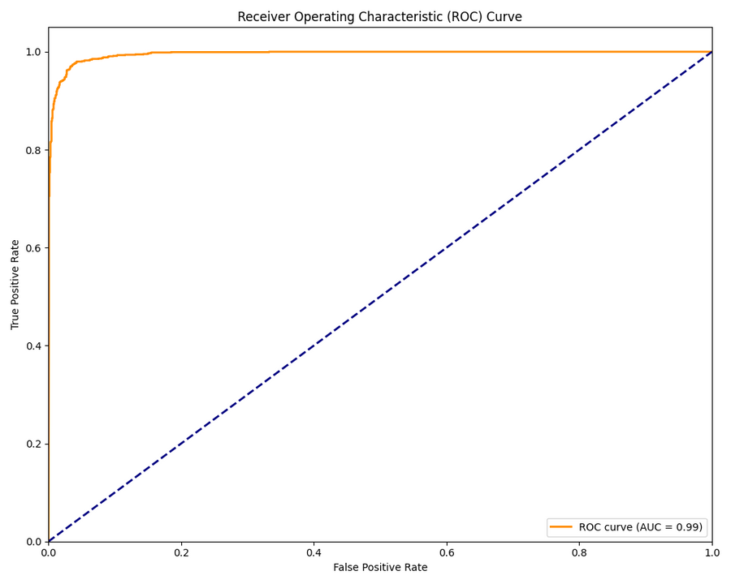
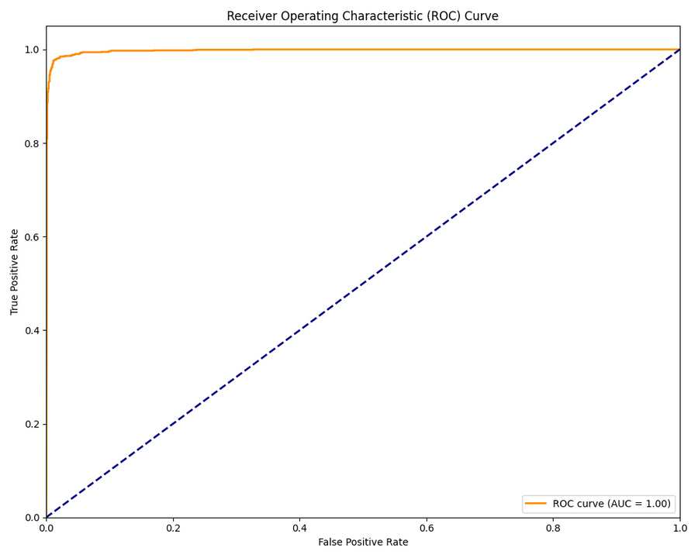
MODEL EVALUATION : INCEPTIONV3 MODEL
Validation Data ROC Curve
Test Data ROC Curve

Slide 13
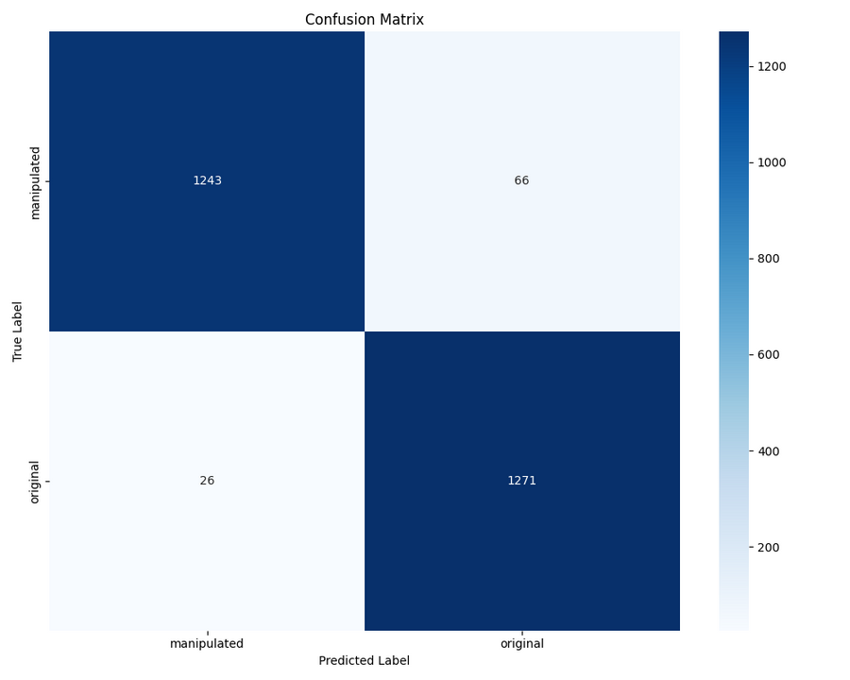
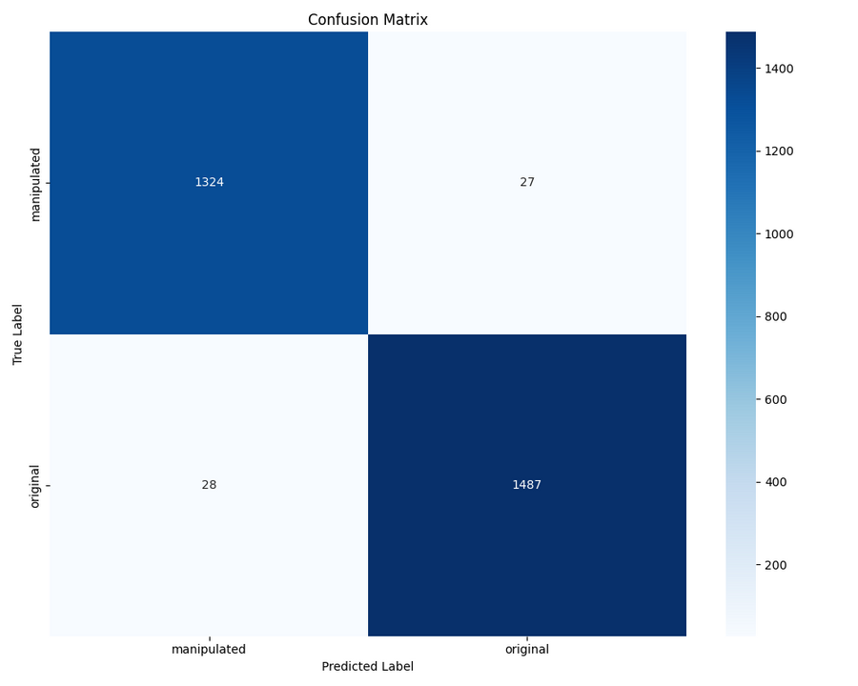
MODEL EVALUATION : INCEPTIONV3 MODEL
Validation Data Confusion Matrix
Test Data Confusion Matrix

Slide 14
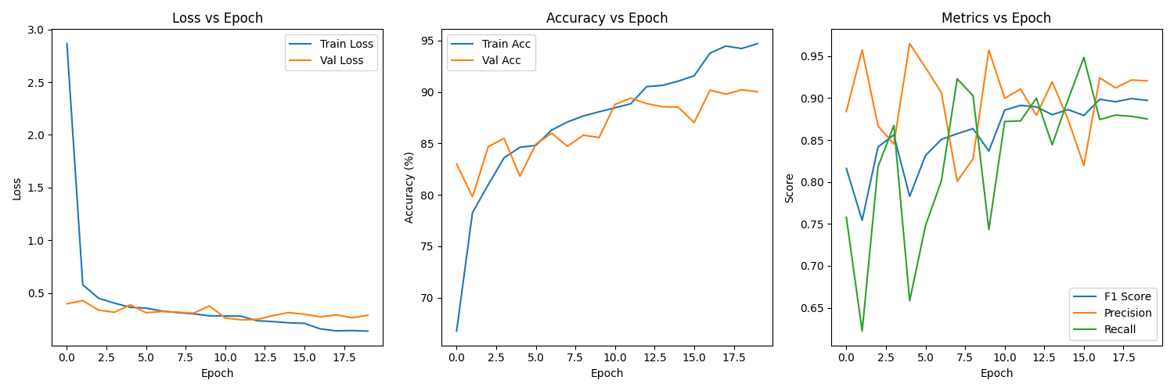
MODEL EVALUATION : RESNET18 MODEL
Training History

Slide 15
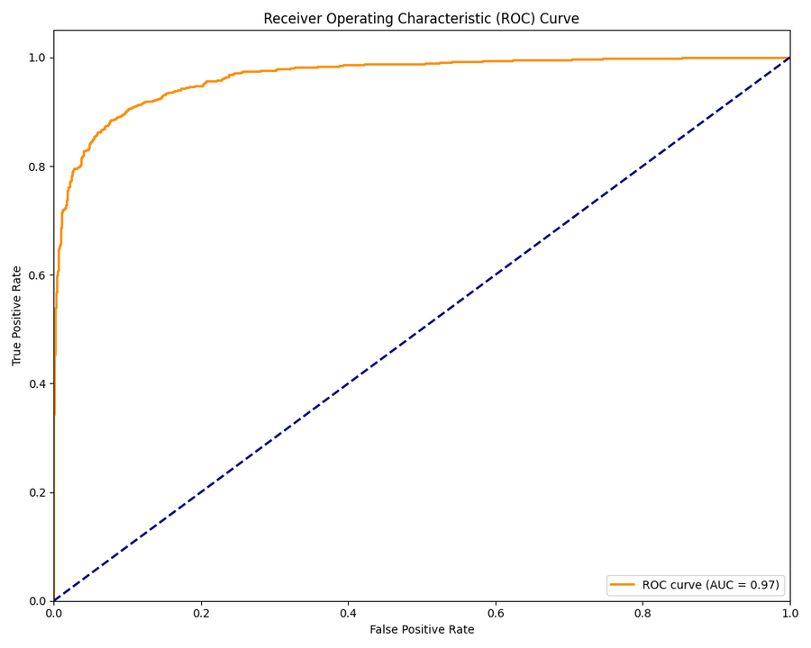

MODEL EVALUATION : RESNET18 MODEL
Validation Data ROC Curve
Test Data ROC Curve

Slide 16
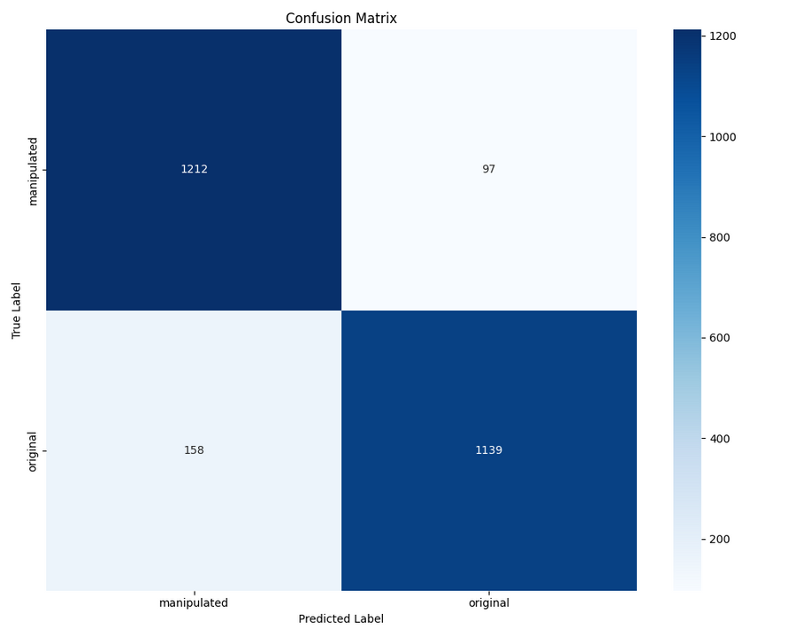

MODEL EVALUATION : RESNET18 MODEL
Validation Data Confusion Matrix
Test Data Confusion Matrix

Slide 17
EXTENDED WORK
Apart from this, we have used a technique of remote PhotoPlethysmoGraphy (rPPG) to detect the DeepFake videos.
PPG is a non-invasive method used to measure changes in blood volume using light absorption.
It is typically extracted from skin regions in videos, especially the face, where color changes reflect heartbeats.
PPG in detecting DeepFakes
Real videos contain natural PPG signals, visible as subtle color fluctuations in skin caused by blood flow.
Deepfake videos often lack consistent or realistic PPG signals because generative models don't accurately replicate physiological cues.
Effective even under compression or low resolution

Slide 18
DATASET AND DATA PREPROCESSING
Used Dataset: Deep Fake Detection (DFD) Entire Original Dataset
It contains total of 3432 videos, out of which 3068 are manipulated and 364 are original.
Data Preprocessing
Extract Region of Interest(RoI) using Haar Cascade classifier.
Extracts mean values from RGB and HSV color spaces
Maintains a history of previous frames to compute differences for temporal changes
Adds ELA (Error Level Analysis) inspired features by taking the mean difference between original and compressed frames.
Normalize all the extracted features for better training.
Padding for same length features

Slide 19
TRAINING THE MODEL
We have considered total 768 videos to train our model, instead of the whole dataset, because of the time and resources contraint.
Out of total 768 videos, we have considered the ratio of 0.7 for training set, 0.15 for validation set and remaining 0.15 for testing set. That results in:
537 Training Images
115 Validation Images
116 Testing Images

Slide 20
TRAINING THE MODEL
Optimizer: AdamW
The model uses AdamW optimizer, which is an improved version of Adam.
It implements weight decay regularization.
Scheduler: CosineAnnealingLR
The learning rate follows a cosine curve, decreasing gradually and then increasing slightly before decreasing again
This cycling helps the model escape local minima and find better optima

Slide 21
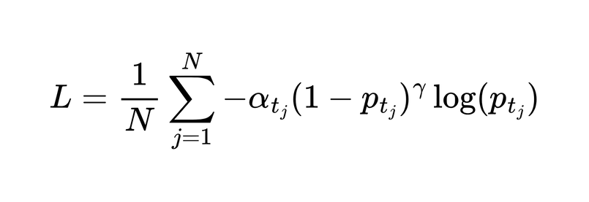
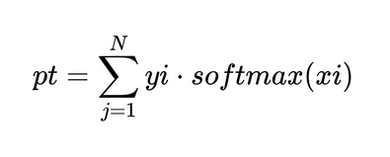
TRAINING THE MODEL
Loss Function: Focal Loss
The custom Focal loss function is defined as:
Where
-the predicted probability for the true class
yi∈{0,1} -
one-hot encoded ground truth label
xi​ - the model's raw output (logits) for class i
alpha - weighting factor
γ- focusing parameter
N- number of classes

Slide 22
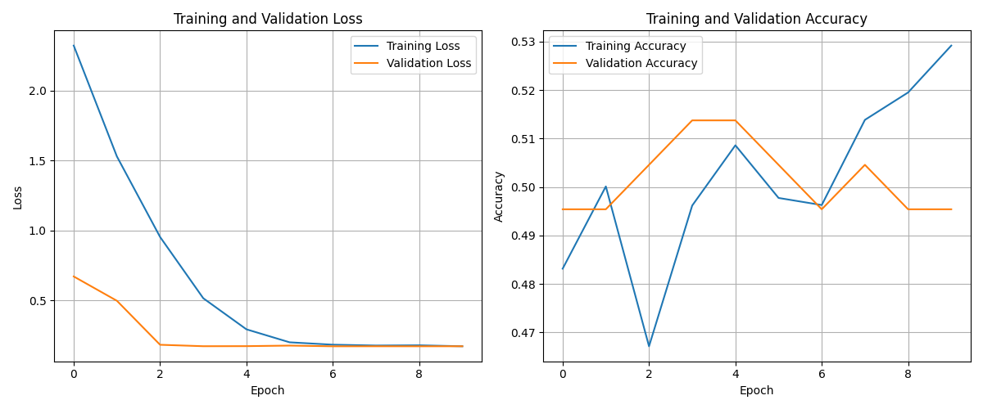
EVALUATION
Training History

Slide 23
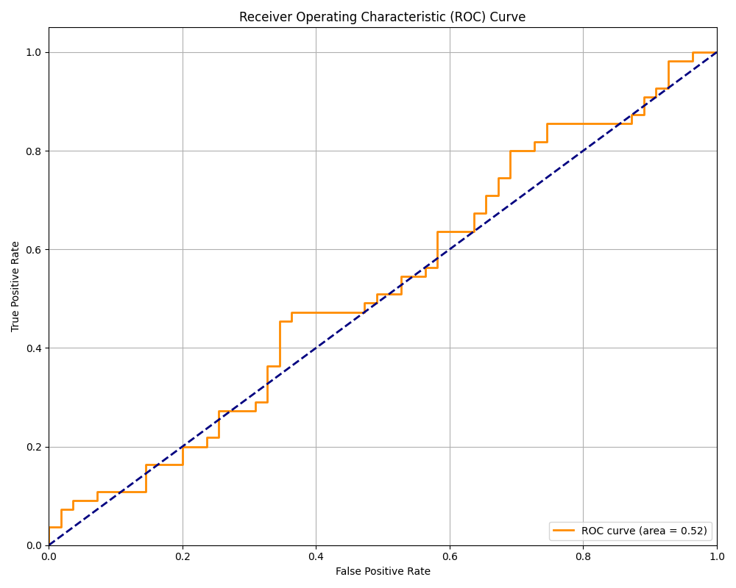
EVALUATION
ROC Curve

Slide 24
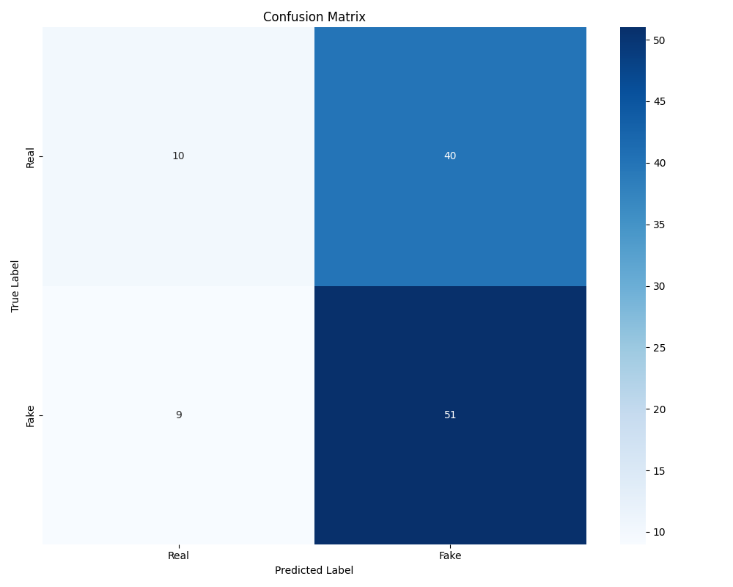
EVALUATION
Confusion Matrix

Slide 25
Thank you!

